Slide 1
Deep Learning with Tensorflow for skin cancer classification
Prepared by University of Bristol
Data Science Faculty

Slide 2


Presented By
Dr. James Pope
Dr. Efi Psomopoulou
Dr. Zahraa Abdallah

Slide 3



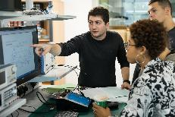
Marketing
Data Science
The future of Health… is Digital
PhD in AI
MSc Data Science
MSc Data Science (Distance Learning)
MSc Financial Technology with Data Science
PhD in Digital Health & Care
MSc Digital Health

Slide 4
Material
Primarily from
Hands-On Machine-Learning with Scikit-Learn, Keras, and Tensorflow. Aurelion Geron.
Book 2nd Edition, Code 3rd Edition
https://github.com/ageron/handson-ml3.git
Andrew Ng via Coursera/Deeplearning.
https://www.coursera.org/specializations/deep-learning

Slide 5
Tentative Schedule
15:00 Introduction
15:15 Lab – Tensor Flow Setup
15:30 Part I
15:45 Lab – Tensor Basic Usage
16:15 Part II
16:35 Lab – Tensor CNNs with Skin Cancer

Slide 6
Session’s Learning Objectives
Gain an introductory understanding of how convolutional neural networks (CNNs) can be used for image classification
Have an awareness of how CNNs can be used for skin cancer classification using Python and Tensorflow
Appreciate how the performance of CNNs can be improved using residual networks and transfer learning

Slide 7
Level of expertise required by attendees
Intermediate-level python programmer with some experience of Jupyter Notebooks / Jupyter Lab / Google Colab is recommended.
Some knowledge of deep learning and convolutional neural networks (CNNs), or exposure to Tensorflow or PyTorch would be beneficial but is not required.

Slide 8
Caution
This material is intended to provide some familiarity with the Tensorflow/CNNs.
Due to time constraints, some concepts will only briefly be introduced so that we can concentrate on code.

Slide 9
The Perceptron
Model == Function
Layer
a₁
weights
(parameters)
activation
function
g(z)
Input
w₁
a₂
w₂
f_{w,b}(a) = g(a^{T}w + b) = y_hat
a
b
a^{T}w = z
...
1
Unit
Similar Logistic Regression, learns linear boundary
What about multiple units in layer?
What about multiple layers?
What about different activation functions?

Slide 10
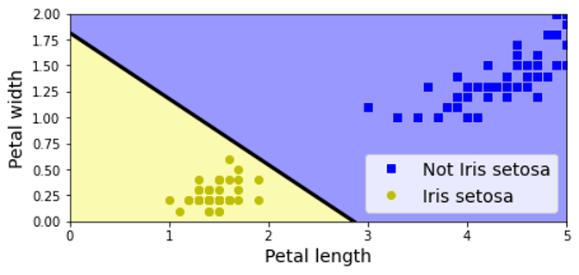
Perceptron Code (sklearn)
1
2
3
4
5
6
7
8
9
10
11
12
13
14
15
16
import numpy as np
from sklearn.datasets import load_iris
from sklearn.linear_model import Perceptron
def main():
iris = load_iris()
X = iris.data[:,(2,3)] # petal length, petal width
y = (iris.target == 0).astype(int) # iris setosa?
# Create model, train on data
model = Perceptron()
model.fit(X,y)
# Evaluate (i.e. predict)
y_pred = model.predict( [[2, 0.5]] )
print(y_pred)
if __name__ == "__main__":
main()
Heaviside step activation makes "hard" decision

Slide 11
Multilayer Perceptron
w₁₁ | w₁₂
w₂₁ | w₂₂
w₁₃ | w₂₃
w₁₄ | w₂₄
W¹ _{4x2}
=
g(.)
W² _{3x4}
a⁰₁
g(.)
g(.)
a⁰₂
g(.)
g(.)
a²
g(.)
g(.)
b¹
b²
a⁰
a¹ = g(W¹ a⁰ + b¹)
a² = g(W² a¹ + b²)
a^{L} = g(W^{L} a^{L-1} + b^{L})
Input Layer
Hidden Layer
Output Layer
Feed-forward neural network

Slide 12
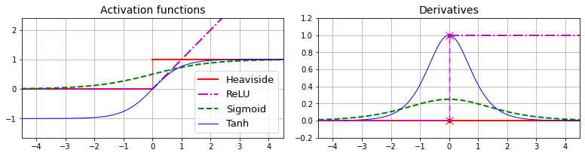
Activation Functions
Activation functions can allow non-linear boundaries
Ideally (easily) differentiable functions

Slide 13
Why do we need TF?
What about multiple units?
What about multiple layers?
What about different activation/loss functions?
How do we create more complex models?
Answer: Tensorflow (or Caffe, or PyTorch...)
"Deep learning frameworks"

Slide 14
What is TensorFlow (TF)?
Tensorflow is a deep learning framework
Numerical library based on Eigen, CUDA, NVidia cuDNN
Mostly written in C++
But also, common layers, models, activation, loss functions...
But also, implementation of backpropagation to learn gradients
We have to use C++ to use Tensorflow?
No. You can but API's for many languages, Python, Java, Go, etc.

Slide 15
What is Keras?
Keras is an API to Deep Learning Framework(s)
Provides simplified access to Tensorflow
Used to support other DL frameworks: Theano, CNTK
Intended to make porting to different DL library easy
Makes model specification easier
PyTorch (sadly) is not supported as a backend
Keras is the default Python API to TF2
Keras is installed when you install TF

Slide 16
Tensorflow Architecture
Your Python Code
Keras (High-API)
language
APIs
Python (Low-API)
C++
Go
Java
...
Local/distributed Execution Engine
kernels
CPU
GPU
Android
iOS
...

Slide 17
Environment: Google Colab
##### Core scientific packages requirement.txt file contents
jupyterlab~=3.4.6
matplotlib~=3.5.3
numpy~=1.23.3
pandas~=1.4.4
scipy~=1.9.1
##### Machine Learning packages
scikit-learn~=1.1.2
# Optional: the transformers library is only used in chapter 16
transformers~=4.21.3
##### TensorFlow-related packages
# If you have a TF-compatible GPU and you want to enable GPU support, then
# replace tensorflow-serving-api with tensorflow-serving-api-gpu.
# Your GPU must have CUDA Compute Capability 3.5 or higher support, and
# you must install CUDA, cuDNN and more: see tensorflow.org for the detailed
# installation instructions.
tensorflow~=2.10.0
tensorboard~=2.10.0
tensorboard-plugin-profile~=2.8.0
tensorflow-datasets~=4.6.0
tensorflow-hub~=0.12.0
# Used in chapter 10 and 19 for hyperparameter tuning
keras-tuner~=1.1.3
# Optional: used in chapters 11 & 16 (for AdamW & seq2seq)
tensorflow-addons~=0.17.1
# Optional: statsmodels is only used in chapter 15 for time series analysis
statsmodels~=0.13.2

Slide 18
GitHub repository + Google Colab
Go to: https://github.com/efipsom/JGI-Tensorflow
Follow instructions to run Notebooks in Google Colab

